Slide 1
Animal Reports
By Mrs. Milton’s Class

Slide 2
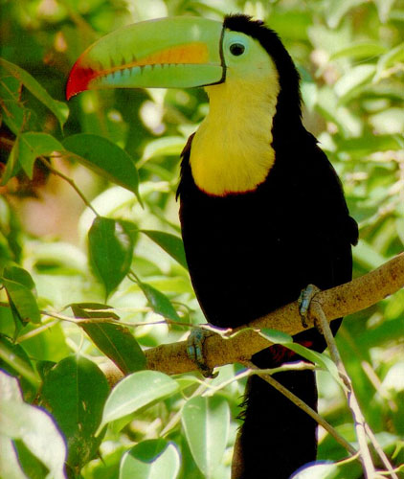
A Life of a Toucan
By Ansley and Aurora

Slide 3
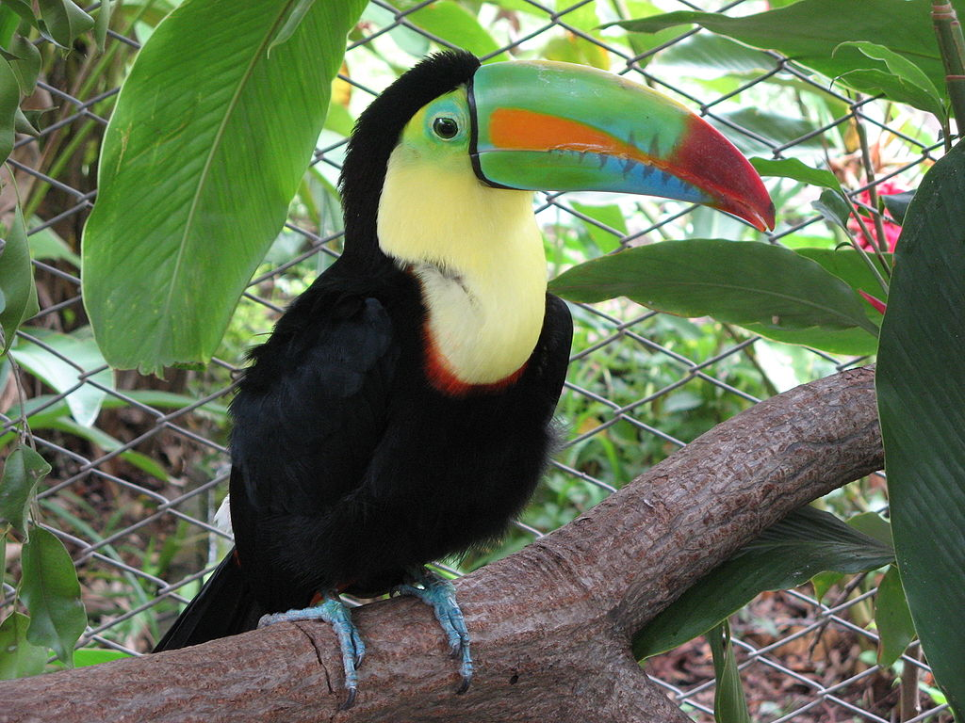
Food
Toucans eat fruit ‘but sometimes prey on insects and small lizards.

Slide 4
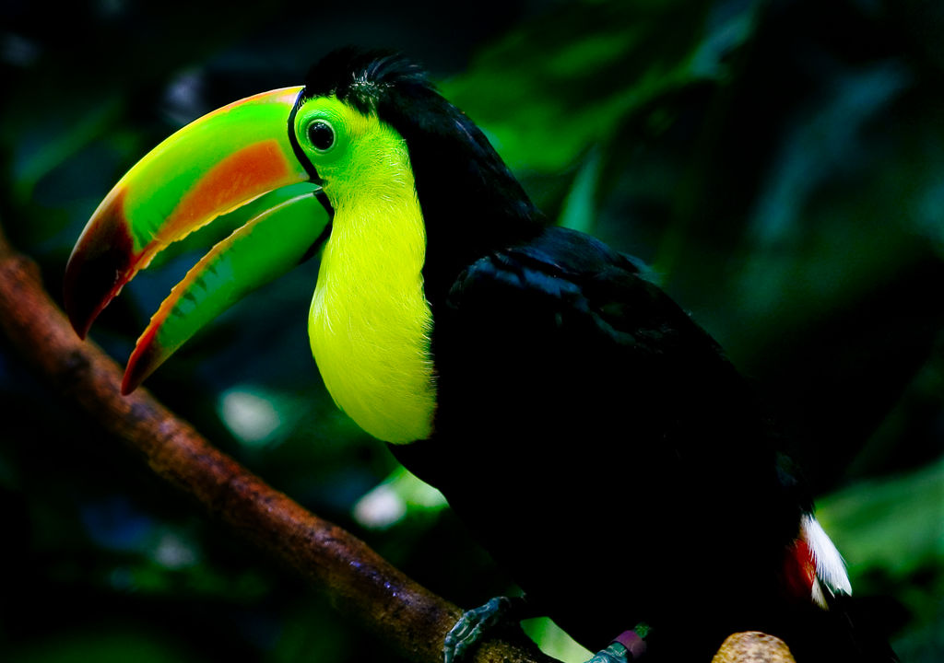
Habitat
Toucans live in tropical jungle regions and they are native to southern Mexico.

Slide 5
Habitat
Toucans live together in small sized flocks.

Slide 6
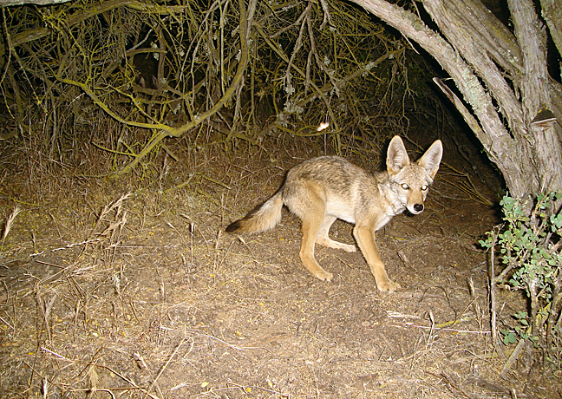
All About Coyotes
By Landon And Noah

Slide 7
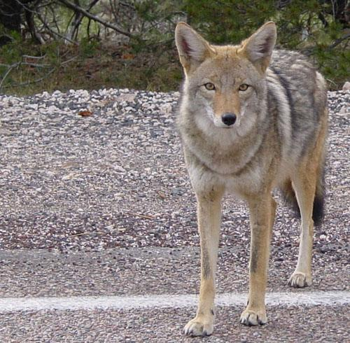
Habitat
Coyotes once lived in prairies and deserts of the western United States and in Mexico.

Slide 8
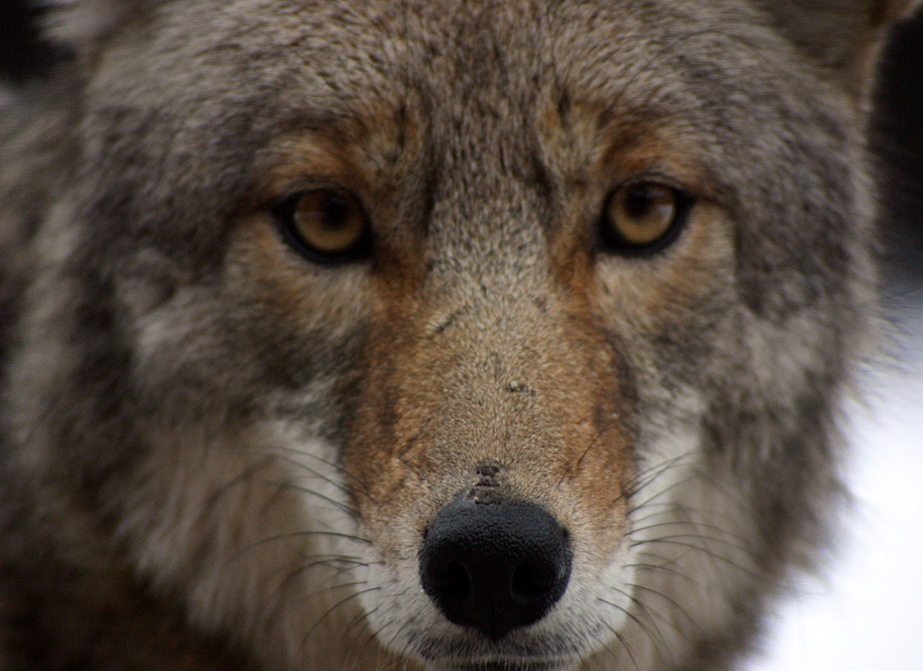
Food
If it can’t find mice or voles to eat ,lizards,insects,or even garbage will do.

Slide 9
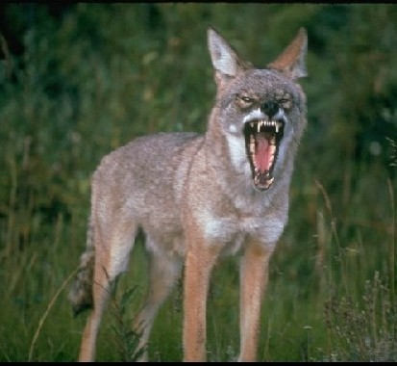
Habitat
Today they thrive almost anywhere in North America.

Slide 10
All About Grizzlybears
By Emeilio cyrus

Slide 11
Habitat
Grizzly bears are found many difrent habitatats
From dens forest to subalpine medows open plains and arctic tundra.

Slide 12
EAT
Grizzly bears eat fish.

Slide 13
Habitat
Forets to subalpine meadows.

Slide 14
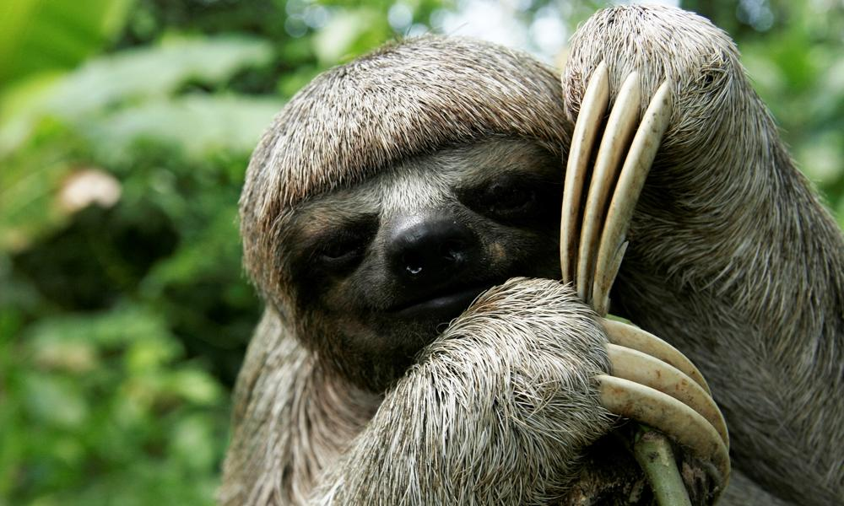
Facts About Sloths
By Vivian and Jenna

Slide 15
Habitat
Sloths live in the Tropical Forests of Central
And South america.

Slide 16
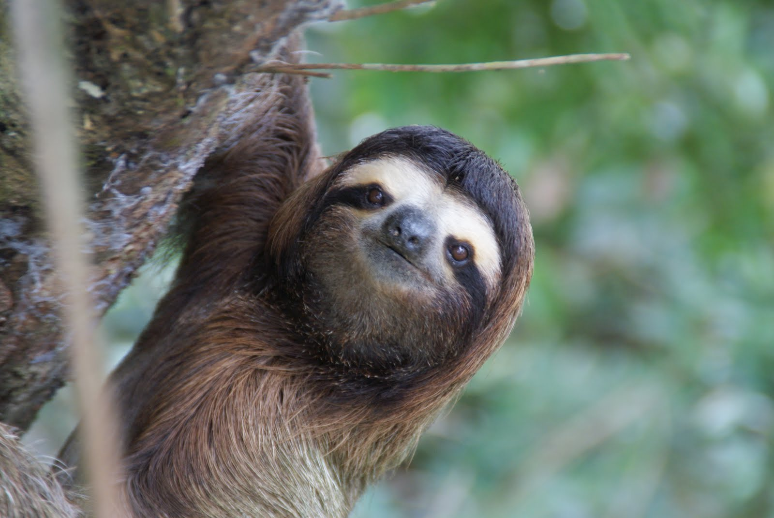
diet
They eat leaves including leaves from the cecropia tree tender young shoots and fruit they
Are herbivores plant eaters.

Slide 17
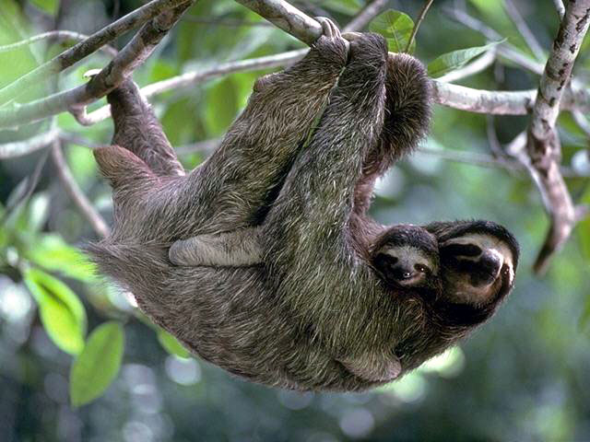
Habitat
The husband and wife team help sloths at
Their animal rescue center.

Slide 18
Lizard Facts
By Kaylee and Jack

Slide 19
Habitat
Rocky and mixed forest areas from sea level to above 9000 ft.

Slide 20
diet
Carnivores eat insects.

Slide 21
habitat
Adapts to wide variety of conditions but not desert.

Slide 22
The Snake
By Julia
christian

Slide 23
habitat
Rattlesnakes live in gasslannds.

Slide 24
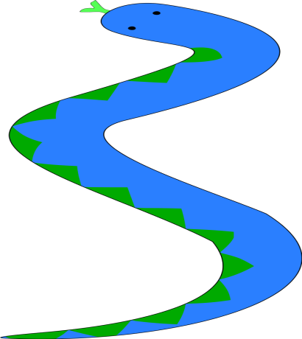
What thay eat
They eat small animals.

Slide 25
The habitat
The habitats must have confert in there home.

Slide 26
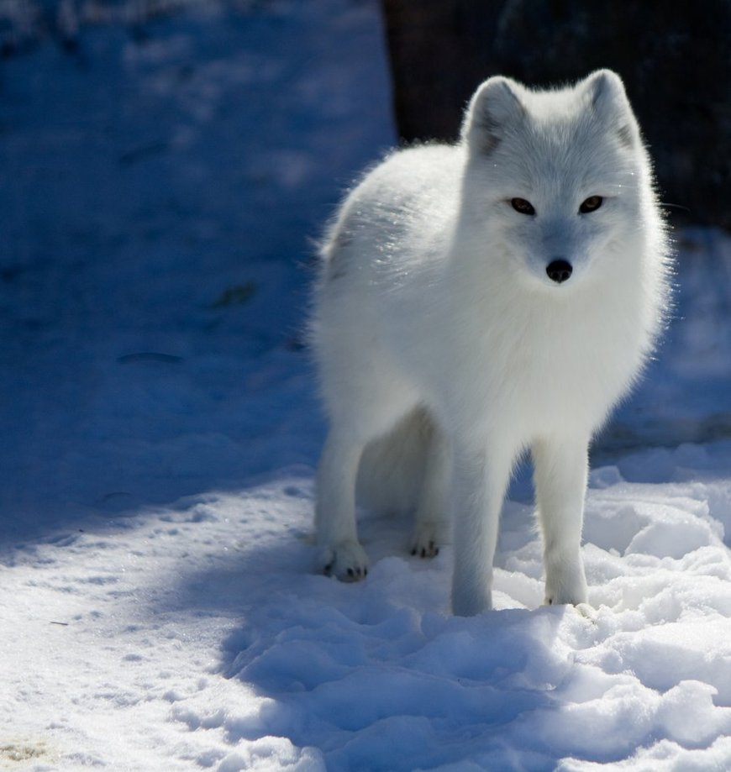
The Arctic Fox
By Cooper And Carter

Slide 27
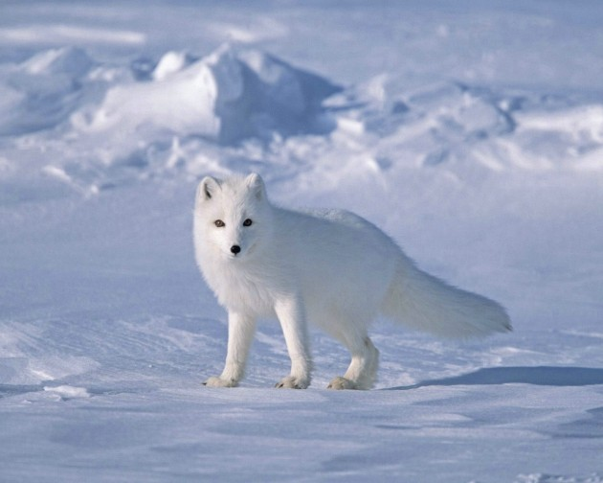
Habitat
They live in the tundra.

Slide 28
Food
They eat birds eggs and fish.

Slide 29
Habitat
They live in a cold place.

Slide 30
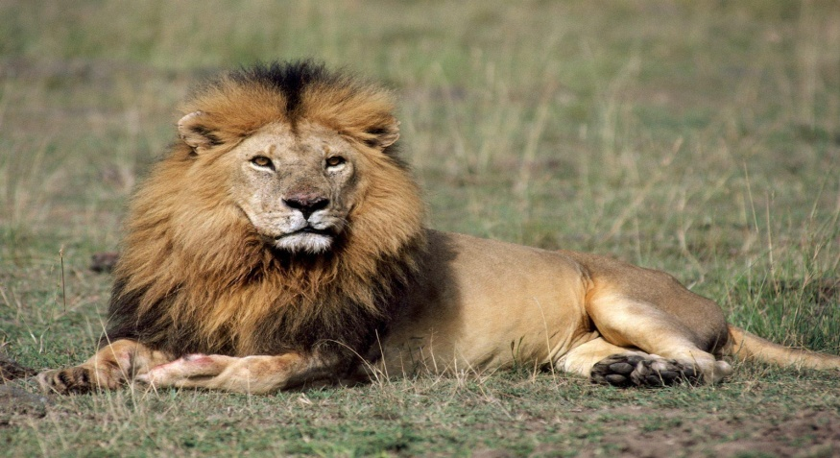
The Lion
By Mann and Nichole

Slide 31
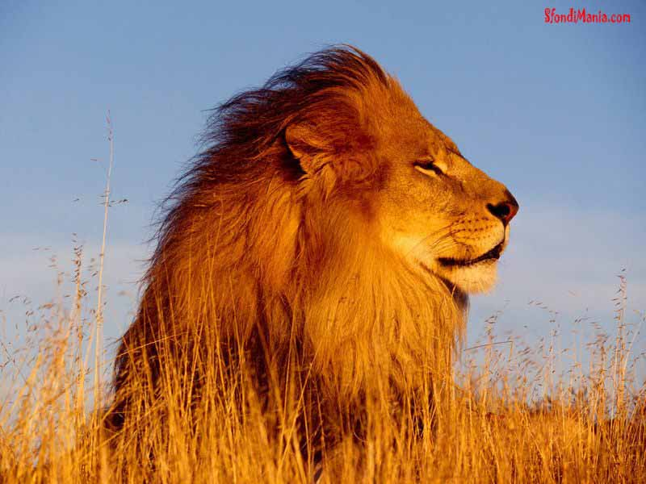
Habitat
They live in the south Sahara desert and in parts of southern and eastern Africa and Greece through the Middle East to northern India.

Slide 32
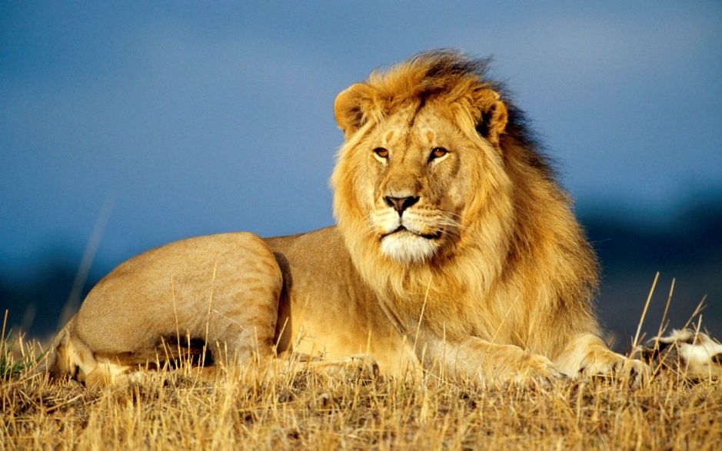
Diet
They eat wildebeest,impala,zebra,girrafe,buffalo,wild hogs,rhinos,hippos,hares,birds,elephants,and reptiles.

Slide 33
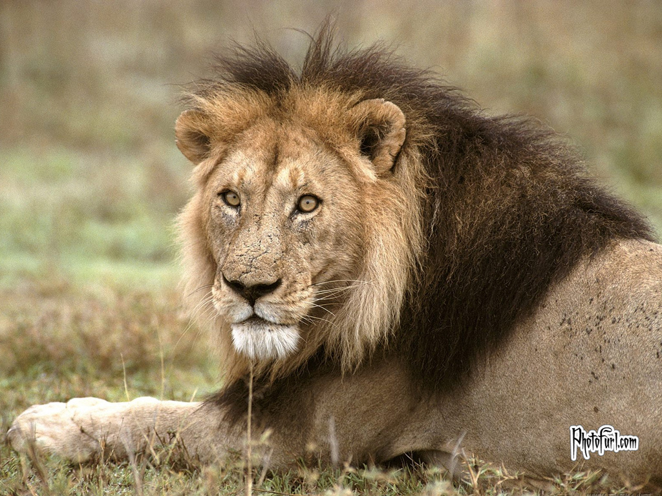
Facts about their habitat
Their habitat has lots of grass.Lions mostly live in the Grasslands.

Slide 34
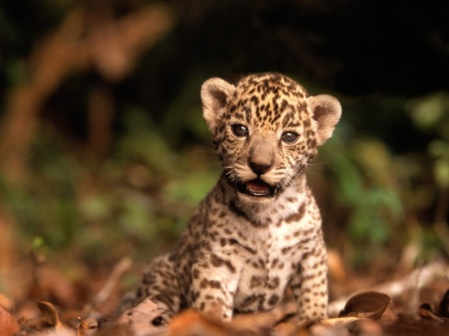
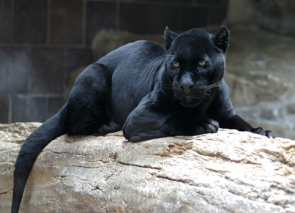
Things about jaguars.
By Maranda and Kara

Slide 35
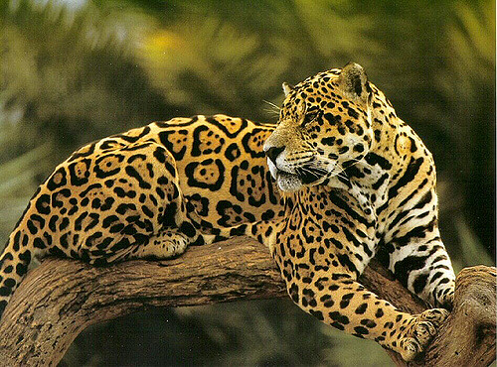
Diet
They eat deer ,peccary, corcodiles,snakes,monkeys,sloths,tapirs,turtle,eggs,frogs,fish.

Slide 36
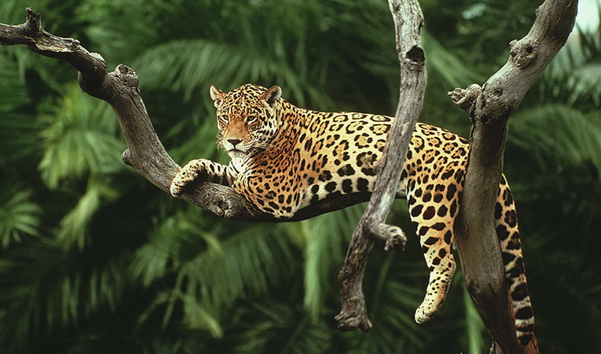
Habitat world
Deciduous forests,rainforests,swamps,pampas,grasslandsand mountain.

Slide 37
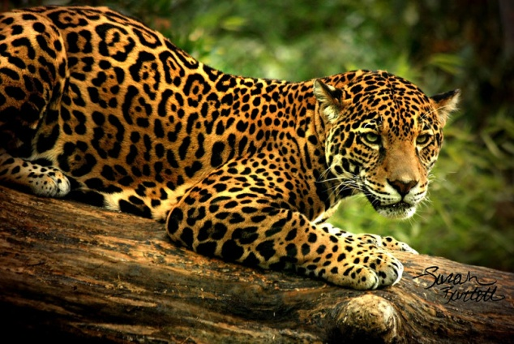
Habitat
They live in tropacol rainforests.

